Slide 1
Laravel
Lab
PHP WebDevelopment 2019
Milena Tomova
Vratsa Software
https://vratsasoftware.com/

Slide 3
Table of Contents
Laravel/Collective
Carbon
DB Facade
Raw Queries

Slide 4



Learn to Search in Internet
The course assignments require to search in Internet
This is an important part of the learning process
Some exercises intentionally have no hints
Learn to find solutions!
Software development includes everyday searching and learning
No excuses, just learn to study!
Developers learn new technologies, tools, languages every day!

Slide 5
Laravel Collective

Slide 6
Laravel Collective - HTML
Laravel Collective
documentation
HTML and form builder

Slide 7
Laravel Collective - HTML
install by
and start using it!
composer require laravelcollective/html

Slide 8
Important
Since this package internally uses
strict comparisons (=== instead of ==)
be careful when passing numeric values into your forms.
Values in HTML are submitted as strings and Laravel old values stored in flash session are strings.

Slide 9
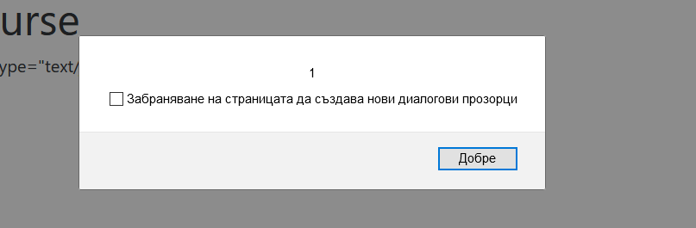
Important {{ }} vs. {!! !!}
@php
$p = '<script type="text/javascript">alert(1)</script>';
@endphp
{{ $p }}
//<script type="text/javascript">alert(1)</script>
{!! $p !!}

Slide 10
Task 1
Transform the forms that
adds level to course
creates new users
updates users
*** create CustomValidation for updating user data

Slide 11
Summary
Since HTML forms only support POST and GET, PUT and DELETE methods will be spoofed by automatically adding an element with a method key in the form opening line;
the model's value matching the field's name will automatically be set as the field value.
So, for example, for a text input named email, the user model's email attribute would be set as the value.
If there is an item in the Session flash data matching the input name, that will take precedence over the model's value.
So, the priority looks like this:
- Session Flash Data (Old Input)
- Explicitly Passed Value
- Model Attribute Data
This allows you to quickly build forms that not only bind to model values,
but easily re-populate if there is a validation error on the server!
…
…
…

Slide 12
Carbon

Slide 13
Task 2
On every resourse page display columns with
date and time when the record has been created
date and time when the record has been updated
in user friendly formats.
For example
2 minutes ago
dd/mm/yy hh:mm:ss

Slide 14
Carbon
Carbon
Carbon is a powerful extension for working with dates -
formatting
comparing
converting
finding difference between dates
telling the day of the week of a date
etc.
Carbon is an international PHP extension for DateTime. http://carbon.nesbot.com
documentation for using Carbon with Laravel

Slide 15
Carbon
Just check your composer.json file for nesbot/carbon package.
In case if you don't have you can install it by typing
and start using it!
composer require nesbot/carbon

Slide 16
Carbon
in case for some reason you wanted to use the diffForHumans() function for a column that is neither created_at and updated_at
...
use Carbon\Carbon;
use ...
class MyController extends Controller{
…
}

Slide 17
Carbon
...
use Carbon\Carbon;
use ...
class MyController extends Controller{
$expire_date_string = '2016-07-27 12:45:32';
// Parse date with carbon - convert it to carbon object
$carbonated_date = Carbon::parse($expire_date_string);
// Assuming today was 2016-07-27 12:45:32
$diff_date = $carbonated_date->diffForHumans(Carbon::now());
echo $diff_date; // prints "1 month after"
}

Slide 18
Carbon
You can add the new column like expired_at to your model:
And then you can use ->diffForHumans();
protected $dates = [
'created_at',
'updated_at',
'deleted_at',
'expired_at'
];

Slide 19
Carbon
Carbon string formatting
echo $user->updated_at;
//2020-10-24 15:50:49
echo $user->updated_at->toDayDateTimeString();
//Sat, Oct 24, 2020 3:50 PM
echo $user->updated_at->toDateTimeString();
//Oct 24, 2020 3:50 PM

Slide 20
Carbon
Carbon comparison
$first = Carbon::create(2012, 9, 5, 23, 26, 11);
$second = Carbon::create(2012, 9, 5, 20, 26, 11, 'America/Vancouver');
var_dump($first->equalTo($second)); // bool(false)
var_dump($first->lessThanOrEqualTo($second)); // bool(true)

Slide 21
Carbon
Carbon Addition and Subtraction
$dt = Carbon::create(2012, 1, 31, 0);
echo $dt->toDateTimeString(); // 2012-01-31 00:00:00
echo $dt->addYears(5); // 2017-01-31 00:00:00
echo $dt->addYear(); // 2018-01-31 00:00:00
echo $dt->subYear(); // 2017-01-31 00:00:00
echo $dt->subYears(5); // 2012-01-31 00:00:00

Slide 22
Carbon
Carbon localization
Carbon::setLocale(‘bg_Bg’);

Slide 23
Carbon
Carbon Create Differences

Slide 24
DB Facade

Slide 25
DB Facade
DB Facade
Largely used in Laravel Database: Query Builder
documentation

Slide 26
DB Facade
DB Facade
Laravel's database query builder provides a convenient, fluent interface to creating and running database queries. It can be used to perform most database operations in your application and works on all supported database systems.
The Laravel query builder uses PDO parameter binding to protect your application against SQL injection attacks. There is no need to clean strings being passed as bindings.

Slide 27
DB Facade
examples querying database using Laravel Query builder
selects
$users = DB::table('users')->select('name', 'email as user_email')->get();
$users = DB::table('users')->distinct()->get();
$users = DB::table('users')->where(‘name’, ‘like’, ‘%test%’)->get();

Slide 28
DB Facade
examples querying database using Laravel Query builder
aggregates
$users = DB::table('users')->count();
$price = DB::table('orders')->max('price');
$price = DB::table('orders')->where('finalized', 1)->avg('price');

Slide 29
DB Facade
building queries dynamically
If you already have a query builder instance and you wish to add a column to its existing select clause, use the addSelect method:
on condition change the query:
$query = DB::table('users')->select('name');
$users = $query->addSelect('age')->get();

Slide 30
DB Facade
Eloquent vs. Query Builder
Eloquent or Query Builder
When we'll work on a simple and small records site with simple CRUD and there records are not fact, then use Eloquent there.
When we'll work on a lot's of records, it is better to use DB Query than Eloquent.

Slide 31
DB Facade
Eloquent vs. Query Builder
I'm making an University website. Which may contain maximum 5,000 teachers and 10,000 students and some notices and files. Then it is better to do this with simple Laravel Eloquent which is very much standard and readable.
Now I'm making a site like Stackoverflow. Which may contains more than 1,000,0000 (1 crore) posts and many more things. I will must choose the conventional DB facades there. It is more faster for searching the posts from so much records.

Slide 32
DB Facade
Eloquent vs. Query Builder
To insert 1000 rows for a simple table Eloquent takes 1.2 seconds and in that case DB facades take only 800 miliseconds(ms).
check your app performance with
Laravel Debugbar

Slide 33
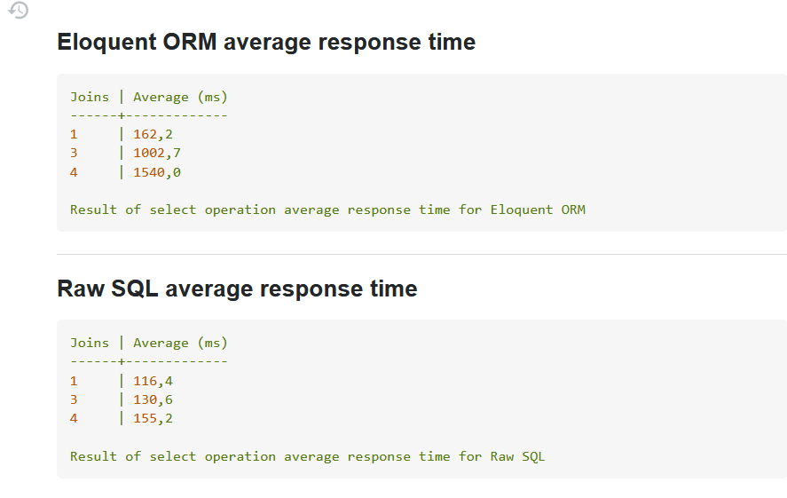
DB Facade
Eloquent vs.
Query Builder
Eloquent or Query Builder
When we'll work on a simple and small records site with simple CRUD and there records are not fact, then use Eloquent there.
When we'll work on a lot's of records, it is better to use DB Query than Eloquent.

Slide 34
Raw Queries

Slide 35
Raw Queries
Raw Queries
Business logic is often complicated.
Or you`ve faced a project with model relations not defined.
Because of this, we often need to write our own SQL queries.
Luckily, Laravel's query builder has the tools we need to safely run such queries.

Slide 36
Raw Queries
Raw Queries
A key concern when writing our own queries is protecting our application from SQL injection attacks.
Normally, the query builder does this for us.
However, when we write our own SQL, we need to make sure we don't inadvertently remove this protection.

Slide 37
DB Facade
here is what we want to avoid:
DB::raw() is used to make arbitrary SQL commands which aren't parsed any further by the query builder.
They therefore can create a vector for attack via SQL injection.
$someVariable = Input::get("some_variable");
$results = DB::select( DB::raw("SELECT * FROM some_table WHERE some_col = '$someVariable'") );

Slide 38
DB Facade
Change the query in a way that sanitizes the user input:
$someVariable = Input::get("some_variable");
$results = DB::select( DB::raw("SELECT * FROM some_table WHERE some_col = :somevariable"),
['somevariable' => $someVariable]));

Slide 39
DB Facade
Use the query in a way that sanitizes the user input:
example:
$results = DB::select('select * from users where id = ?', [1]);

Slide 40
DB Facade
Use the query in a way that sanitizes the user input:
result is an array of obj or update and delete statements return the number of rows affected by the operation
$results = DB::select('select * from users where id = ?', [1]);
DB::insert('insert into users (id, name) values (?, ?)', [1, 'Dayle']);
DB::update('update users set votes = 100 where name = ?', ['John']);
DB::delete('delete from users');

Slide 43



Trainings @ Vratsa Software
Vratsa Software – High-Quality Education, Profession and Jobs
www.vratsasoftware.com
The Nest Coworking
www.gnezdoto.vratsasoftware.com
Vratsa Software @ Facebook
www.fb.com/VratsaSoftware
Slack Channel
www.vso.slack.com

